Slide 1

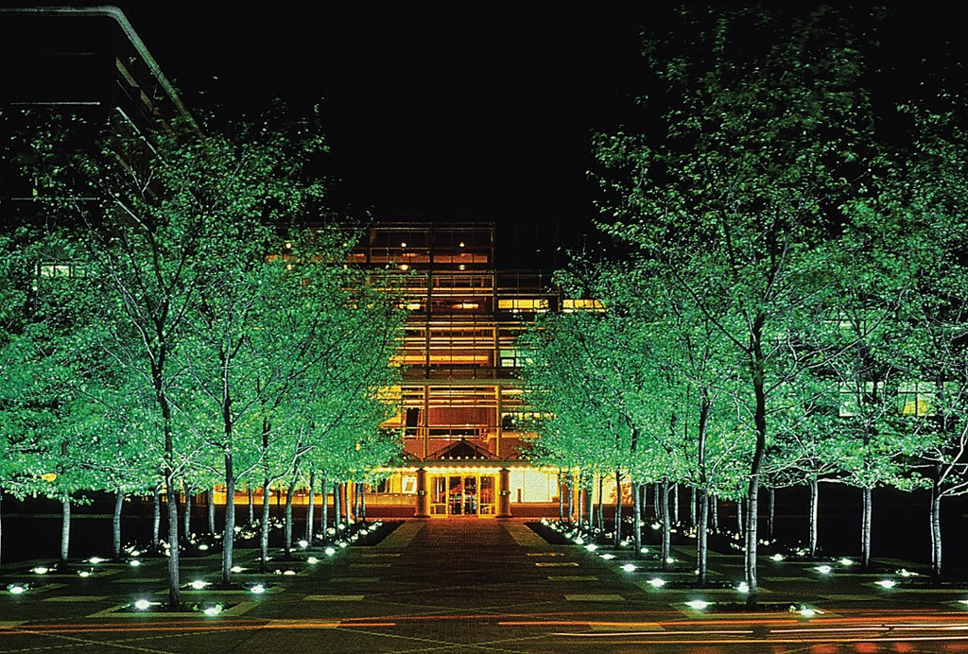

Bithika Innovates Pvt Ltd
REPAIR REFURBISH
REUSE
BUILDING A SUSTAINABLE FUTURE
LED LUMINAIRES
01
www.bithikainnovates.com

Slide 2

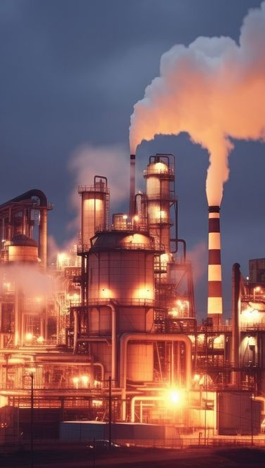
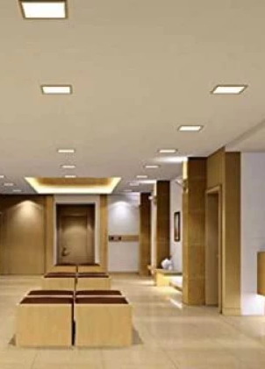
ELECTRONICS INDUSTRY
  Since its emergence in the 20th century, electronics has been a key player and one of the largest global industry.
  It’s versatility has not only made it one of the fastest growing but also the most usable comodities as it promotes convienience
  Owing to its widespread use and popularity, no wonder it is also the fastest growing waste stream.
  The world produces upwards of 50 million tonnes of e-waste per year which contains toxic chemicals like mercury and brominated flame retardants that easily seep into the soil and waterways
02

Slide 3

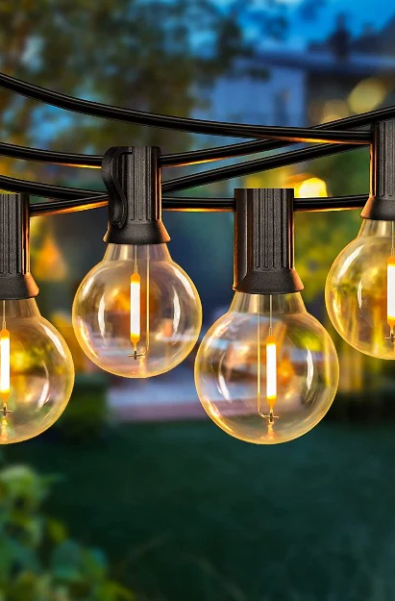

LED LUMINAIRES
  The primary advantage of LED based lighting systems are their energy efficiency and longer life span.
  Owing to the reducing prices, increased awareness and promotions, the popularity of such luminaires has increased and so there usage also.
  Longer life cycles and decreasing prices has shadowed an important benefit of repairability.
  The life expectancy of such products can be further enhanced to extract much more judicious use of not only the elctronics but also the plastics and metal that go in the products.
03

Slide 4
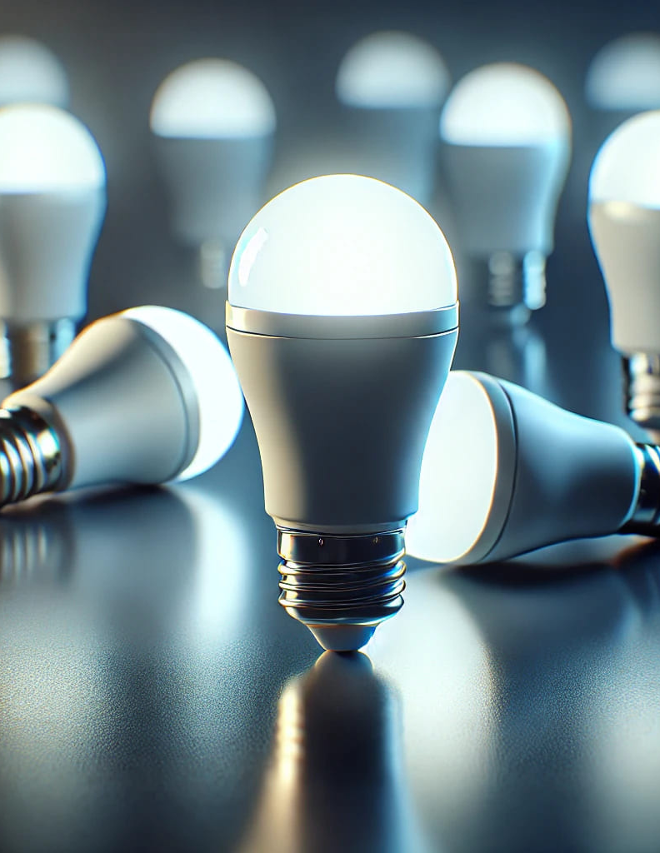

INTRODUCTION TO REPAIR, REFURBISH & REUSE (RRR)
  Repair, refurbish and reuse unlike the reduce, recycle and reuse concept, is not a disposal strategy but rather a restoration strategy whereby the existing products are not disposed off post their useful life but are recovered and restored to their full performance, a better alternative to waste mangement in the first place.
  This not only makes it more cost effective but also reduces the carbon foot print due to extended usage.
  A centuries old concept which has lost its shine to the market competition and reducing costs, has once again started to regain its popularity as the world looks towards sustainability and environment restoration.
Over the years in manufacturing, we have recognised that the life of LED Luminaires can be substantially increased with no degradation in performance and most of their components are reusable.
04

Slide 5
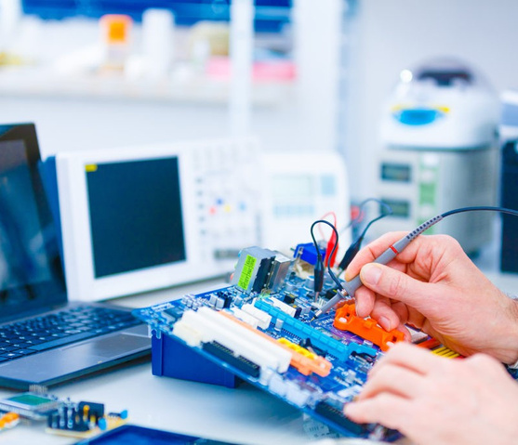
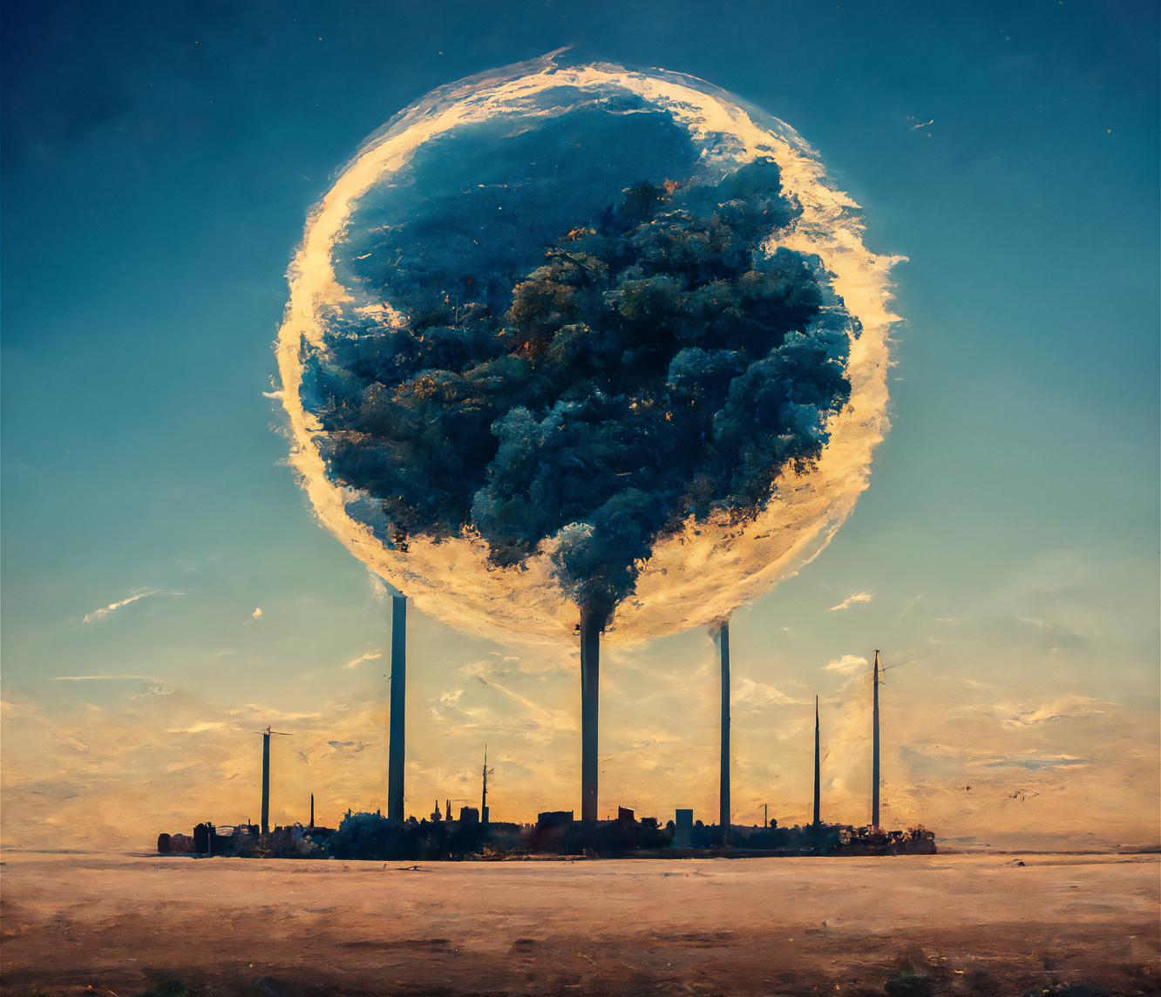
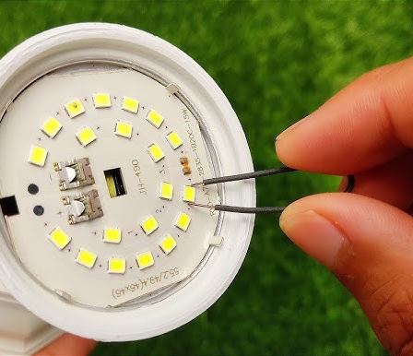
BENEFITS OF REPAIR, REFURBISH AND REUSE
  Cost savings.
  Promotes circular economy.
  Reduced carbon footprint
  Satisfaction owing to contribution towards sustainable environment
  Increased inventory of products due to addition of repaired/refurbished assets.
05

Slide 6

CHALLENGES AND SOLUTIONS
Despite the many benefits, the implementation of RRR faces various challenges, including the supply chain disruptions and poor quality local level repairs which generally do not restore full performance to provide warranty.
At Bithika Innovates, we provide professional, economical and high quality repair/refurbishment to the luminaires with warranty. We prefer not to charge if we cannot restore full performance whilst offering better scrap value and responsible disposal of such products.
06

Slide 7

WHAT DO WE OFFER ?
Bithika Innovates offers the following services:
  Cost effective repair/refurbishment of suitable luminaires with minimal/no change in performance in accordance with industry standards.
  Industry unique, limited warranty on serviced products along with in-house test reports.
  Transparent invoicing whereby we only charge the material costs of spares and man-hour based labour charges plus the taxes. Zero fees, if we cannot restore.
  Better scrap value and proper disposal of products which are beyond economical repairs (BER).
  Scheduled & in-time delivery.
07

Slide 8

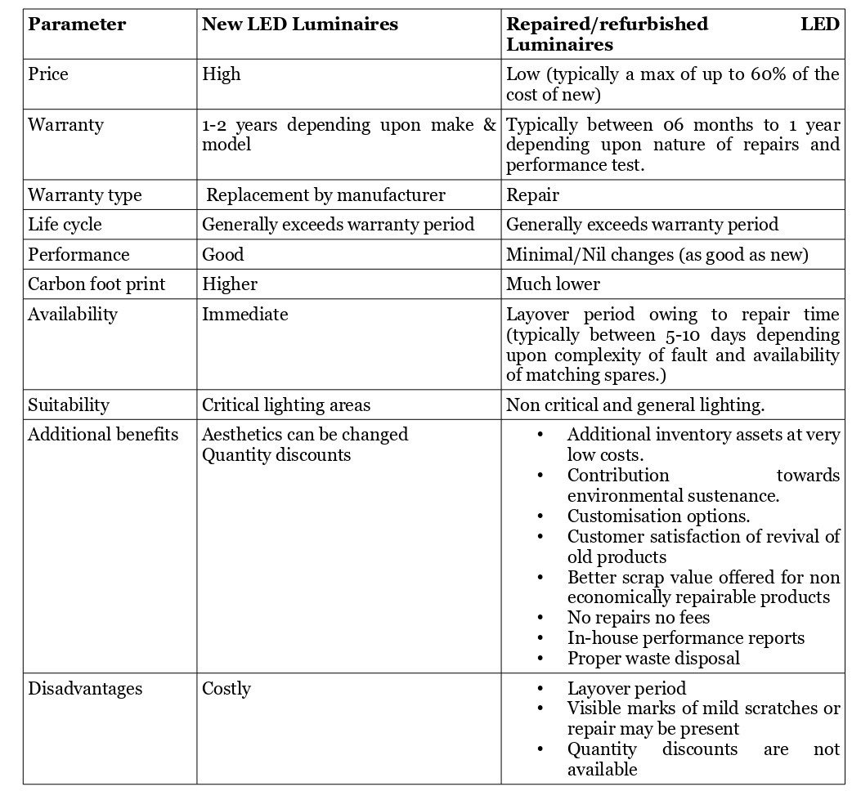
COMPARATIVE STUDY
08

Slide 9

In conclusion, the urgency of addressing climate change and transitioning to sustainable solutions cannot be overstated. Each one of us has a crucial role to play in supporting the adoption of green practices and technologies. The olive branch has been extended and it is only time that the global and Indian population recognise the potential and start taking advantages of such practices.
09

Slide 10

THANK YOU
10
www.bithikainnovates.com

